Slide 1
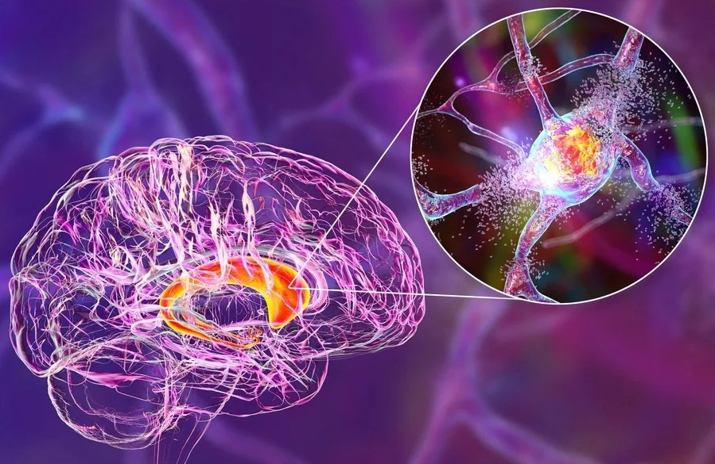
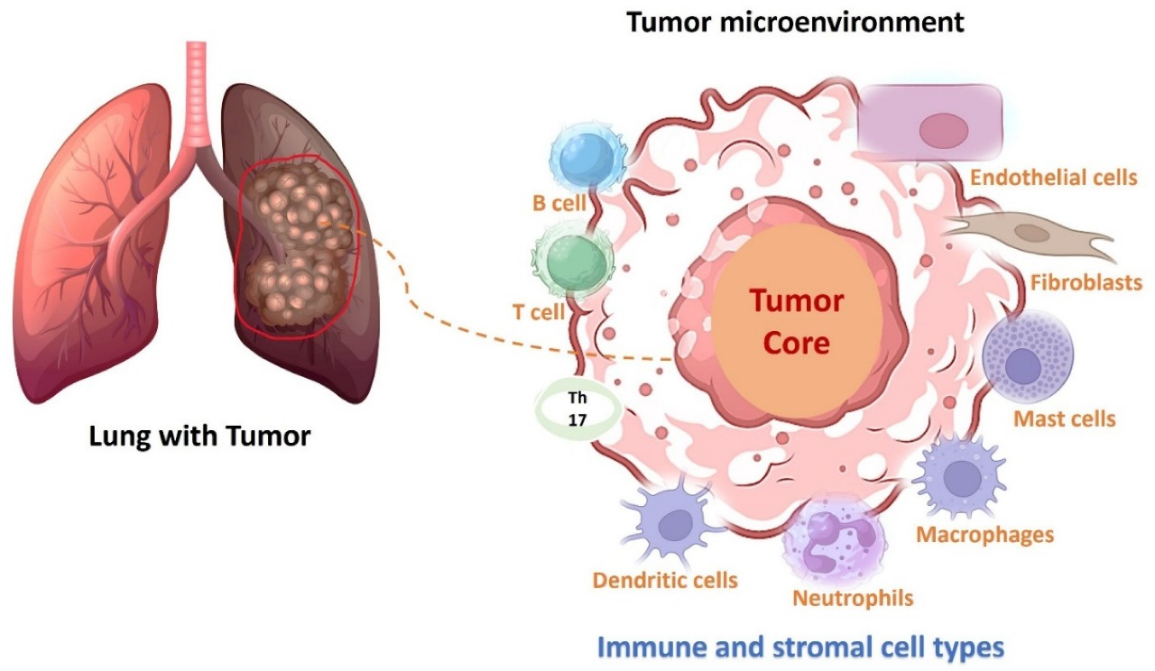
Exploring Molecular
Crossroads Between Cancer
Neurodegenerative Disorders
and Neurodegenerative
Disorders
Through R-Driven Omics Data Integration
and Biomarker Identification
Anupama Satyarthi, Amit Kumar, Rihab Bensalek, Hammed Sheriffdeen Oladimeji, Esha Shahbaz, Yusuf Munir Aliyu
01

Slide 2
Table of Contents
Introduction & Disease Background
01
Research context, lung cancer anatomy and mechanisms, Huntington's disease pathology
Methodology & Pipeline
02
Automated bioinformatics workflow, data processing steps, quality control procedures
Results & Analysis
03
Quality control metrics, PCA analysis, differential expression results, pathway comparison
Discussion & Future Directions
04
Pipeline performance, cross-disease insights, limitations, and future research opportunities
02

Slide 3


Introduction - Research Context
CORE RESEARCH QUESTION
Why study cancer and neurodegenerative diseases together?
1
2
3
Molecular Crossroads
Shared Pathways
Bioinformatics Power
Despite different clinical manifestations,
Identifying overlapping mechanisms
Automated omics integration enables
cancer and neurodegeneration share
can reveal novel therapeutic targets and
systematic, reproducible cross-disease
common molecular pathways involving
improve understanding of both disease
analysis at scale, uncovering patterns
cell survival, protein homeostasis, and
classes at the molecular level
invisible to traditional approaches
stress responses
This research: Leverages R-driven bioinformatics pipelines to systematically identify shared biomarkers and pathways between lung
cancer and Huntington's disease
03

Slide 4
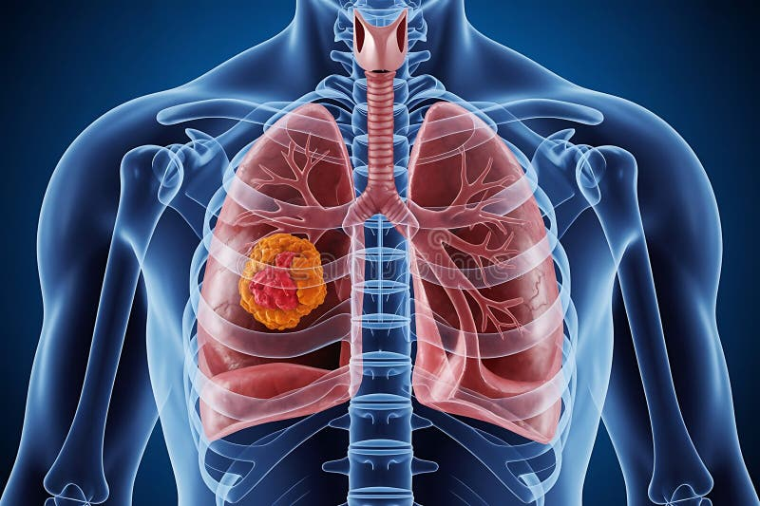
Lung Cancer - Anatomy & Pathology
Respiratory System Anatomy
1
Lungs are paired organs in the thoracic cavity responsible for gas exchange.
Tumors typically develop in bronchi or alveolar tissue
Tumor Location & Growth Patterns
2
2
Cells grow uncontrollably forming tumors that can obstruct airways, invade
surrounding tissue, and metastasize to distant organs
Early Detection Challenges
3
Often asymptomatic in early stages, making detection difficult. Symptoms
appear when disease is advanced, emphasizing need for molecular
biomarkers
Figure 1: 3D Visualization of respiratory system
showing tumor location
04

Slide 5
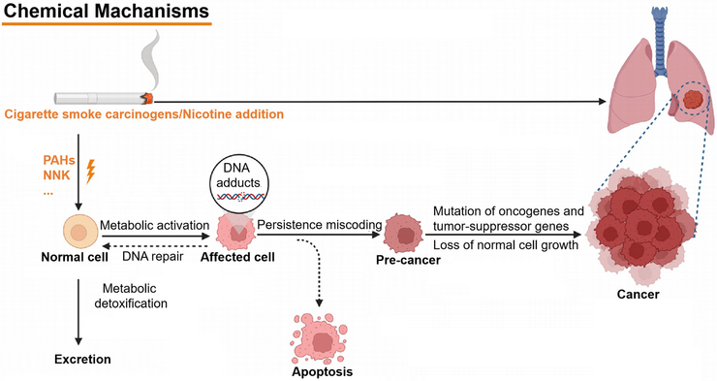
Lung Cancer - Mechanisms
Uncontrolled Cell Growth
1
Loss of cell cycle checkpoints and apoptosis
resistance lead to unregulated.
proliferation, forming malignant tumors.
2
Molecular Drivers
Key mutations in EGFR, KRAS, TP53, and
ALK activate oncogenic signaling
pathways (PI3K/AKT, MAPK) driving tumor progression.
3
Tumor Microenvironment
Angiogenesis, immune evasion, and stromal
remodeling create a supportive.
niche for tumor growth and metastatic spread.
Figure 2: Dynamic visualization of cancer
cell proliferation and invasion
05

Slide 6
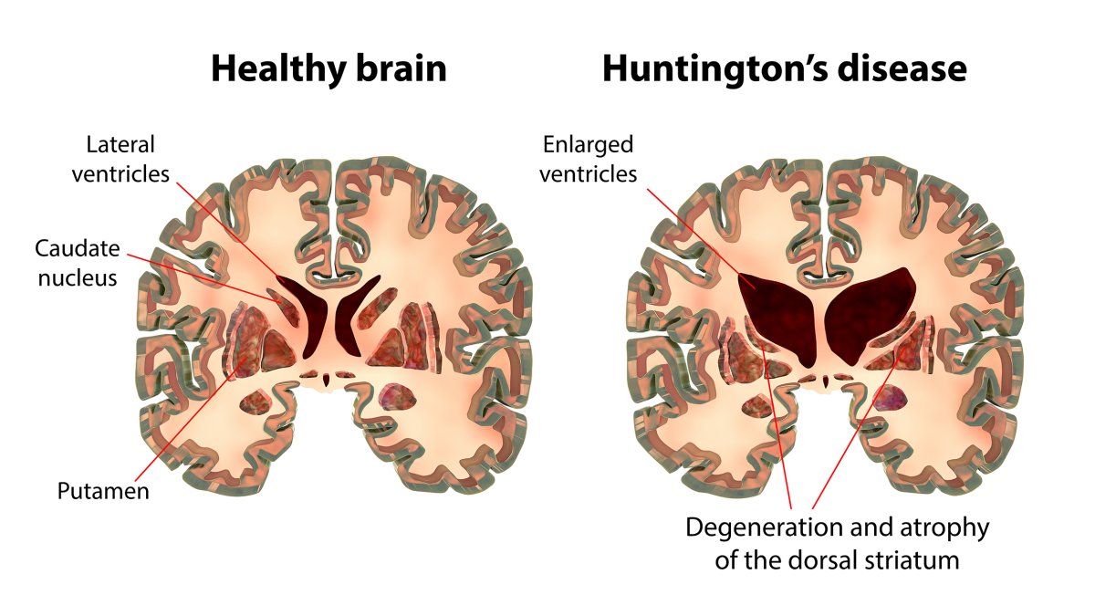



Huntington's Disease - Anatomy & Pathology
Brain Regions Affected
Progressive neuronal damage primarily in the striatum (caudate
nucleus and putamen) and cortex, leading to enlarged
ventricles and brain atrophy
CAG Repeat Expansion
Caused by expanded CAG trinucleotide repeats in the HTT gene
(>36 repeats), producing mutant huntingtin protein with
toxic polyglutamine tract
Progressive Neuronal Damage
Leads to motor dysfunction (chorea, rigidity), cognitive decline,
And psychiatric symptoms with inevitable progression
over 15-20 years
Figure 3: Comparison of healthy brain vs. Huntington’s
disease brain showing striatal atrophy
06

Slide 7



Huntington's Disease - Mechanisms
Protein Misfolding & Aggregation
Mutant huntingtin forms toxic protein aggregates and inclusion
bodies in neurons, disrupting cellular proteostasis and triggering
aggregate-mediated toxicity.
Neuronal Dysfunction Pathways
Impaired mitochondrial function, transcriptional dysregulation,
excitotoxicity, and disrupted axonal transport contribute to
progressive neuronal death
Clinical Impact
Results in motor symptoms (involuntary movements, rigidity),
Cognitive decline (executive dysfunction, memory loss), and
emotional changes (depression, irritability)
Figure 4: Progressive neuronal degeneration in Huntington's disease
07

Slide 8
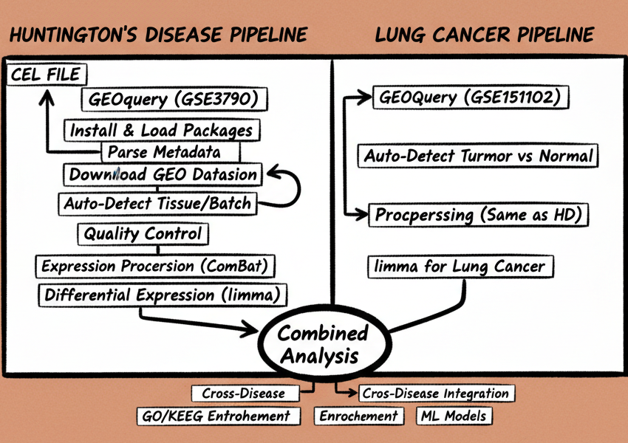
Methodology - Pipeline Overview
Automated R-driven bioinformatics workflow
Data Acquisition
1
Download GEO datasets (GSE3790, GSE151102)
Preprocessing & QC
2
Normalize, filter, boxplot, PCA analysis
3
Batch Correction
ComBat adjustment for tissue effects
4
Differential Expression
limma analysis for DEG identification
5
Cross-Disease Integration
GO/KEGG enrichment, biomarker comparison
08

Slide 9
Methodology - Data Processing Steps
Install & Load Required Packages
Download GEO Data
Extract Expression & Phenotype Metadata
Normalize & Filter Low Quality Genes
Repeat pipeline for lung cancer dataset
Differential Expression (limma)
Batch Correction (ComBat)
Quality Control (QC)
(Boxplot + PCA)
09

Slide 10
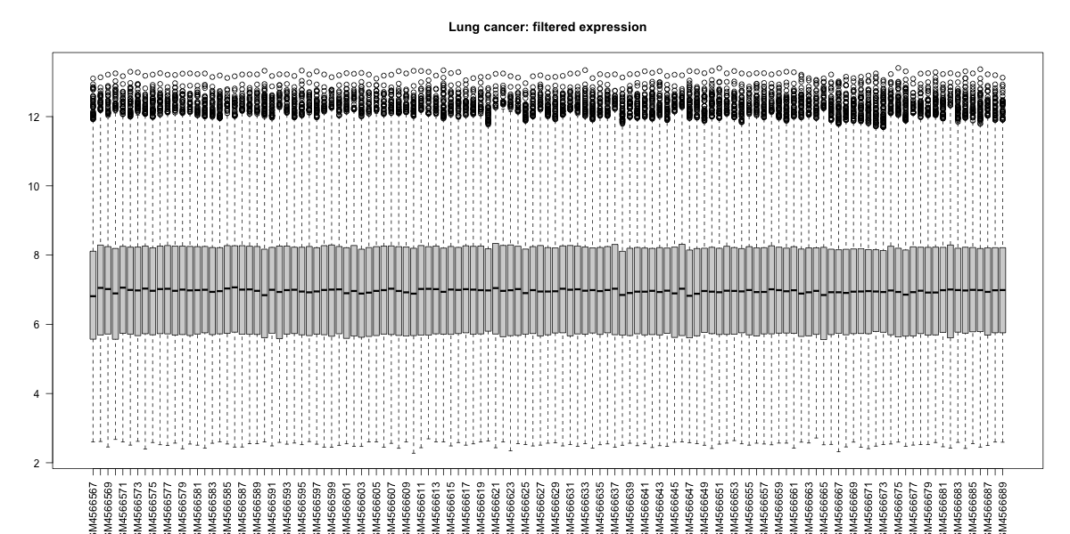
Results - Lung Cancer QC (Boxplot)
QUALITY CONTROL ASSESSMENT
Normalized Expression Distribution:
Consistent medians: Normalized expression shows well-aligned medians
across all lung cancer samples, indicating successful normalization.
Even distribution: Uniform spread across samples suggests absence of
major technical artifacts or batch effects.
Data quality: Clean data suitable for downstream PCA and differential
expression analysis
Conclusion: The boxplot confirms high-quality preprocessed
data with no critical outliers, ready for robust statistical analysis
Figure 5: Normalized Expression Boxplot
10

Slide 11
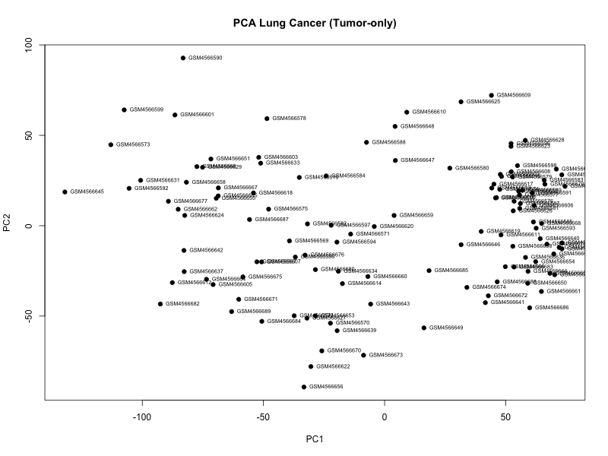
Results - Lung Cancer PCA
PRINCIPAL COMPONENT ANALYSIS
Variance Structure & Sample Distribution:
High heterogeneity: Tumor samples show wide dispersion across
principal components, reflecting molecular diversity typical of cancer.
No distinct clusters: Absence of clear subtype separation suggests no
strong molecular subtypes within this dataset.
Minimal batch effects: Few outliers detected with no critical technical
batch effects requiring correction
Conclusion: PCA confirms biological variability dominates very technical noise, validating data quality for differential expression analysis
Figure 6: PCA Plot of Variance Structure and Sample
11

Slide 12
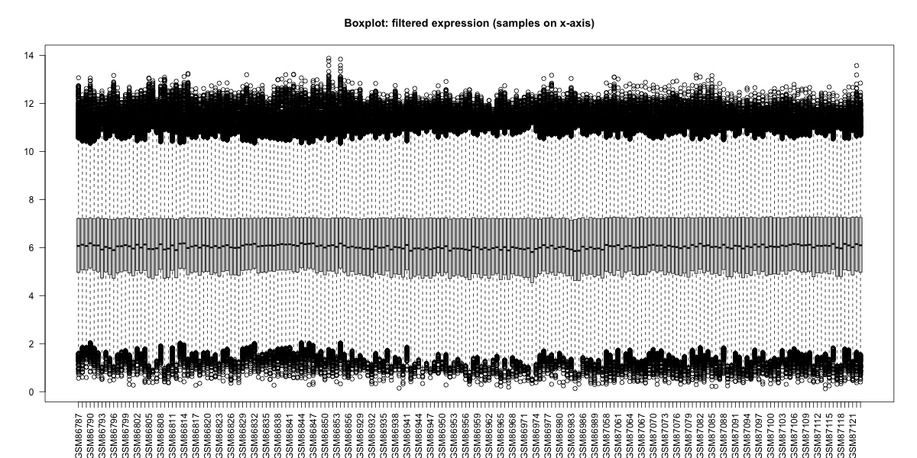
Results - HD QC (Boxplot)
QUALITY CONTROL ASSESSMENT
Expression Distribution in HD Dataset:
Aligned medians: Generally consistent median expression levels
across samples, indicating successful normalization
Variation in spread: Visible differences in expression spread reflect
underlying biological differences between brain regions
(e.g., cortex, caudate)
Batch correction necessary: Mild discrepancies indicate need for
batch correction to reduce tissue-driven variability
Conclusion: The boxplot reveals biological heterogeneity across
brain regions, justifying the use of ComBat for proper batch
adjustment
Figure 7: Expressed Distribution Boxplot
12

Slide 13
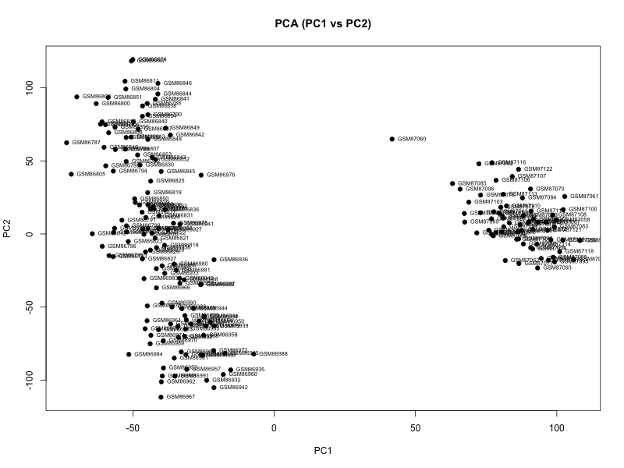
Results - HD PCA
PRINCIPAL COMPONENT ANALYSIS
Batch Effect Detection in HD Dataset:
Two major clusters: PCA reveals distinct sample groupings that
correspond to different brain regions, consistent with metadata
Strong tissue/batch effect: Clear separation indicates presence of a
strong batch effect before correction, driven by tissue origin
Justifies ComBat adjustment: These patterns validate the need for
proper batch correction to isolate disease-related signals
Conclusion: The PCA clustering pattern confirms significant
tissue-driven variance, necessitating ComBat for accurate
differential expression analysis
Figure 8: PCA Plot of Batch Effect Detection
13

Slide 14
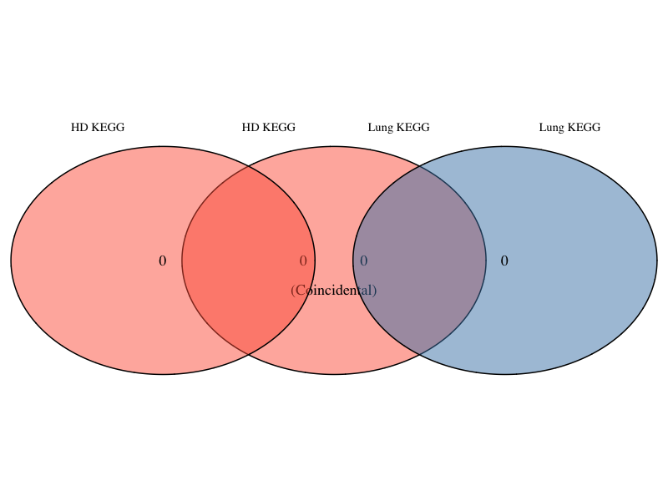
Results - KEGG Pathway Comparison
CROSS-DISEASE PATHWAY ANALYSIS
HD vs Lung Cancer KEGG Pathways:
No overlapping pathways detected: The Venn diagram shows no shared KEGG
pathways between HD and lung cancer datasets
Possible explanations: Small DEG lists, strict significance cut-offs, or
insufficient signal for KEGG enrichment
Disease-specific signatures: Results suggest distinct molecular mechanisms
dominate each disease at the pathway level
Figure 9: Venn Diagram Showing HD-Lung
KEGG Pathways
Interpretation: The absence of shared KEGG pathways indicates disease-specific
molecular signatures at the chosen significance thresholds, though shared
mechanisms may exist at the gene level.
14

Slide 15
Discussion - Pipeline Performance
1
Automated Workflow Success
2
Reliable Metadata Parsing
The automated workflow successfully handled end-to-end
Metadata parsing and auto-detection of disease status
processing, from GEO download to DEG extraction, reducing
(HD/Tumor vs Control/Normal) worked reliably across
manual errors and ensuring reproducibility
inconsistent GEO annotations
3
Adaptive Batch Correction
4
Robust QC & DEG Generation
Tissue/region inference enabled appropriate use of ComBat
Expression preprocessing (log2 + dual-rule filtering)
produced stable matrices, and limma analysis generated
biologically meaningful DEGs for both diseases
batch correction in the HD dataset, improving PCA separation
and biological signal
Overall: The pipeline demonstrated adaptive, decision-based processing with consistent QC and precise contrasts after
adjusting for batch/tissue effects where relevant
15

Slide 16
Discussion - Cross-Disease Insights
1
Shared Stress-Response Pathways
2
Validated Biological Signatures
Cross-disease integration identified shared, opposite, and
GO/KEGG enrichment confirmed known biological
signatures: neurodegeneration-related pathways in
HD and immune/proliferation pathways in cancer
unique DEGs between HD and lung cancer, revealing
overlapping stress-response and metabolic pathways
3
Key Strengths
4
Acknowledged Limitations
Full automation, reproducibility, robust QC, modular design,
Dependence on metadata quality, potential misclassification
and flexibility to scale across datasets demonstrate the
of unusual tissue names, and linear assumptions in ComBat
pipeline's practical utility
require careful consideration
Overall: The pipeline provides a fast, reproducible, and biologically meaningful framework for transcriptomic
analysis and cross-disease comparison
16

Slide 17
1
Fully Automated Pipeline
Achieved end-to-end reproducible processing from GEO data retrieval to DEG generation
with automatic condition and batch detection
2
Adaptive Preprocessing & QC
Intelligent preprocessing with log transformation, dual-rule filtering, and ComBat batch
correction ensured clean, high-quality expression matrices
Conclusion
3
Robust DEG Analysis
Limma-based differential expression produced biologically meaningful DEGs for both
Key achievements of the automated
bioinformatics pipeline for cross-disease
analysis
lung cancer and Huntington's disease
4
Cross-Disease Integration
Successfully identified shared pathways, opposite trends, and disease-specific molecular
signatures between cancer and neurodegeneration
5
Scalable Framework
Provides a reliable, modular tool for systematic multi-dataset transcriptome analysis
applicable to diverse disease comparisons
17

Slide 18
Future Directions
Strengthening Dataset Quality & Analysis
Cross-Disease Integration & Validation
1
Larger Datasets
4
Multi-Omics Integration
Use larger GEO datasets with more samples to increase
statistical power and improve DEG detection reliability
Strengthen HD-lung cancer comparisons through meta-analysis, network-based approaches (WGCNA, STRING), and proteomics/metabolomics data
2
Enhanced Pathway Enrichment
5
Experimental Validation
Improve sensitivity using relaxed FDR cut-offs, GSEA/GSVA
methods, and careful gene ID validation
Perform qPCR validation and literature-supported functional tests for key DEGs and pathways identified in the analysis
3
Advanced Batch Correction
Leverage detailed brain-region metadata and explore advanced methods like
Harmony and RUV for HD datasets
Goal: Build a robust, validated framework for systematic multi-disease transcriptomic analysis with clinical translation potential
18

Slide 19
Acknowledgement
This research would not have been possible without the unwavering support and collaborative efforts of our group members. It was truly a pleasure working together as a team.
Research Supervisors
We extend our deepest gratitude for their invaluable mentorship, expertise, and consistent support throughout this project. Their guidance greatly shaped both the direction and the overall quality of this research project.
Collaborators & Team Members
We sincerely appreciate their technical assistance, insightful discussions, and collaborative spirit. Their contributions enriched this work and helped create a productive and inspiring research environment.

Slide 20
Thank You
Questions?
Members:
20

